Slide 1
DIGITAL WATERMARKING TO HIDE TEXT MESSAGES
BY-
Shaina Mehta
-A2305219268
Tanya Yadav
-A2305219295

Slide 2
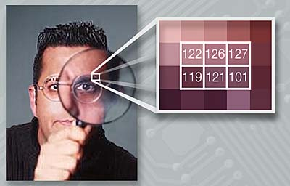
INTRODUCTION
01

Slide 3
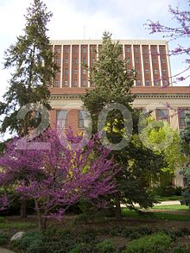
What is Watermarking?
Digital Watermarking is use of a kind of marker convert embedded in a digital media such as audio, video or image which enables us to know the source or owner of the copyright. This technique is used for tracing copyright infringement in social media and knowing the genuineness of the notes in the banking system.

Slide 4
Types of Watermarks
Visible Watermarks
Invisible Watermarks
Public Watermarks
Fragile Watermarks

Slide 5
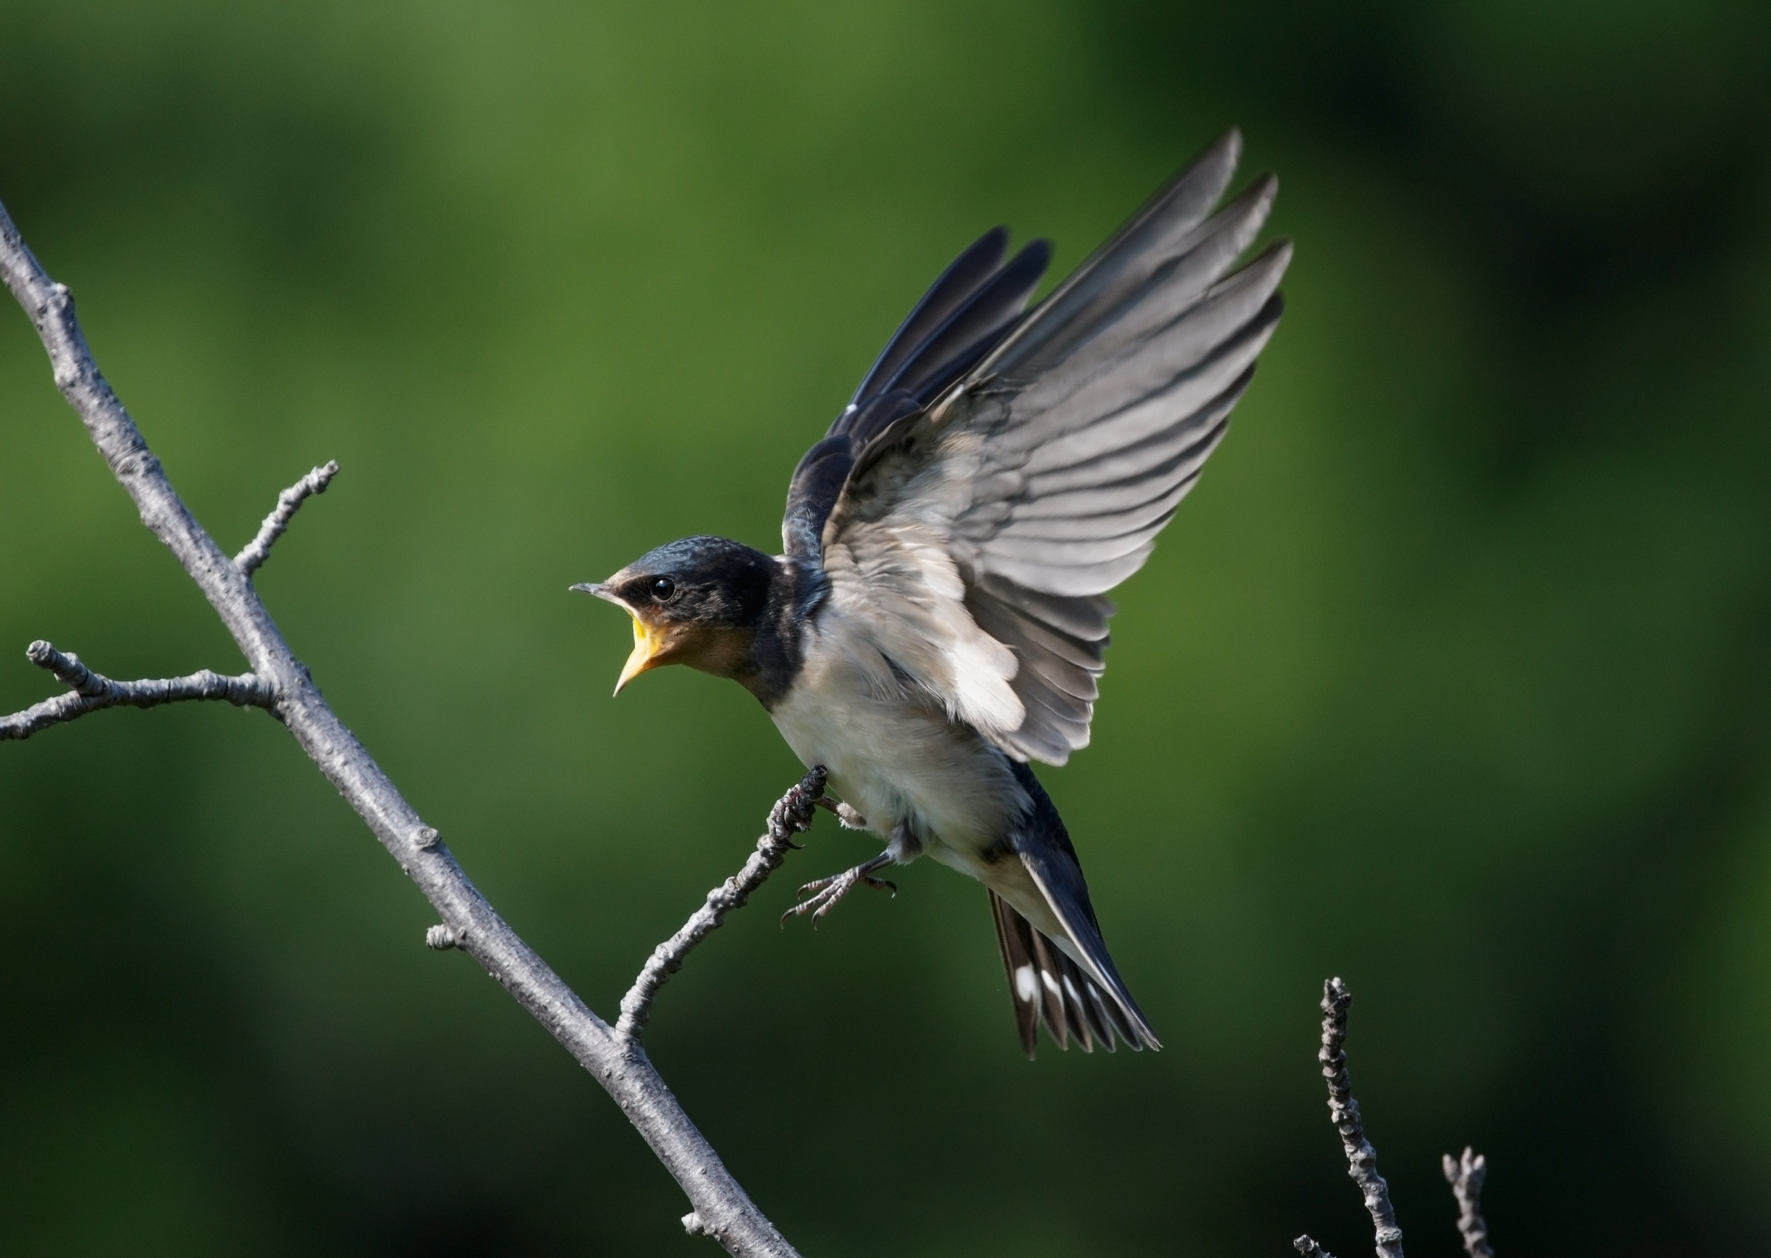
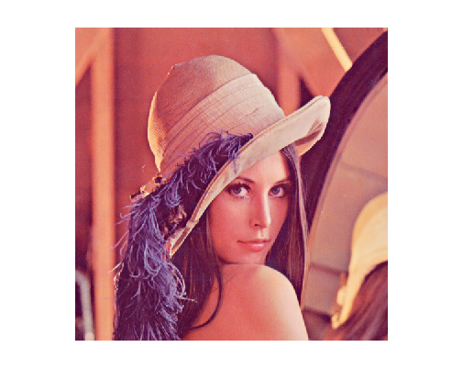
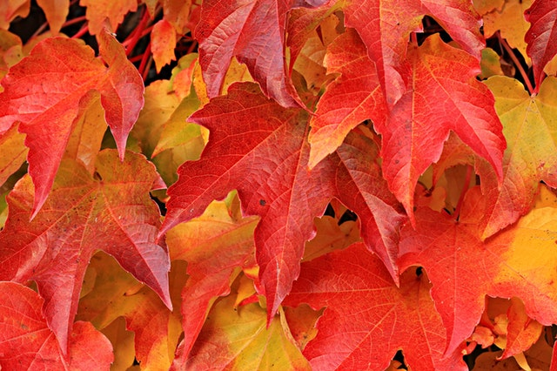
Literature Review
Steganography
Discrete Cosine Transform
AES – 128 Encryption System

Slide 6
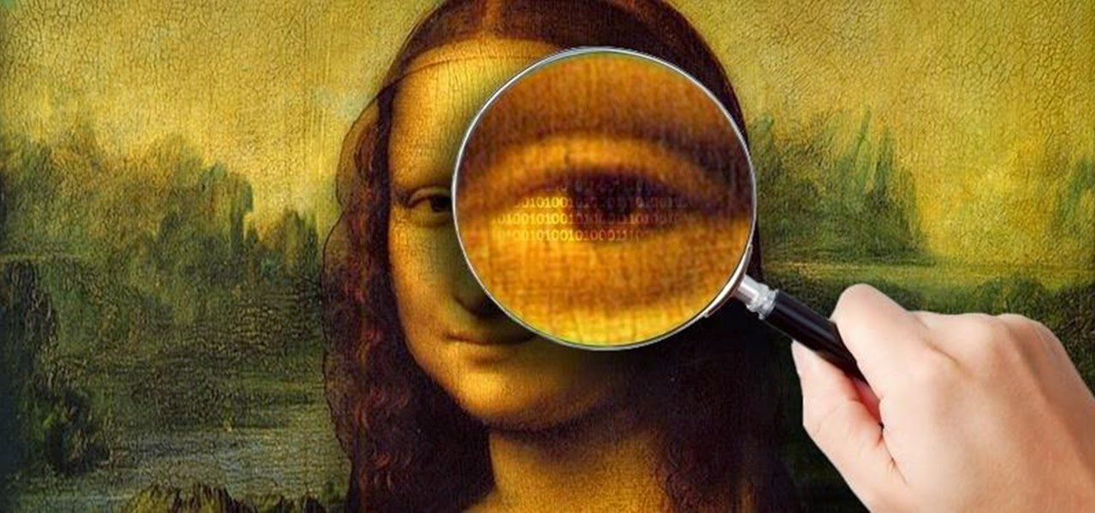
What is Image Steganography?
Image Steganography is the process of hiding information which can be text, image or video inside a cover image. The secret information is hidden in a way that it not visible to the human eyes. The image selected for this purpose is called the cover image and the image obtained after steganography is called the stego image.

Slide 7
Approaches Used For Image Steganography
Spatial Domain Technique
Masking and Filtering
Transforma-tion Techniques

Slide 8
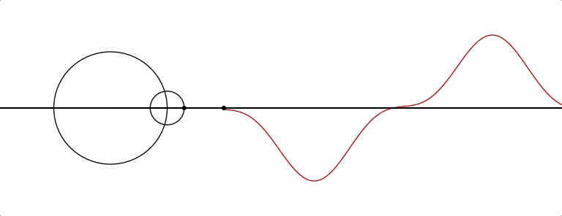
About Discrete Cosine Transform (DCT)
The discrete cosine transform (DCT) is a transformation method that separates the image into parts (or spectral sub-bands) of differing importance (with respect to the image's visual quality).
Similar to the discrete Fourier transform: it transforms a signal or image from the spatial domain to the frequency domain.
Widely used transformation technique in signal processing, image processing and by far the most widely used linear transform in data compression.

Slide 9
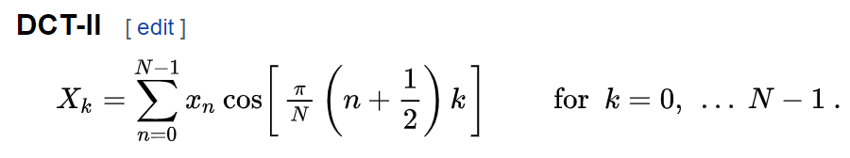
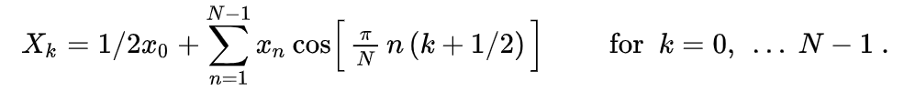
Formulae
DCT - II
DCT – III or IDCT

Slide 10
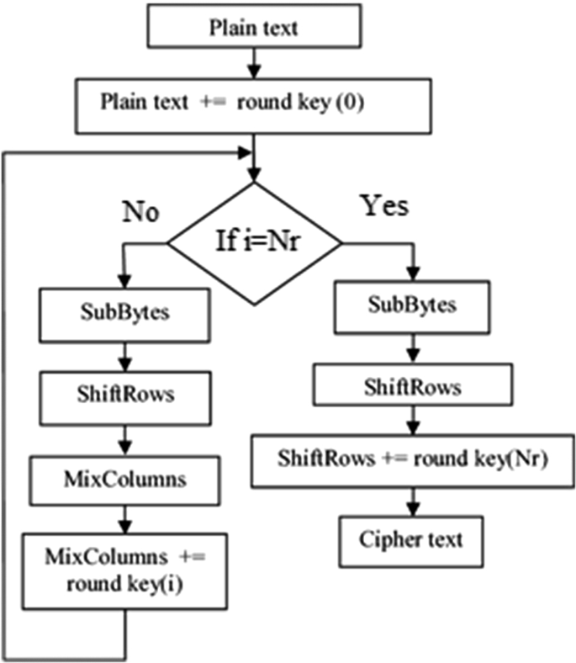
About AES Encryption System
The Advanced Encryption Standard (AES) is a symmetric block cipher chosen by the U.S. government to protect classified information.
AES is implemented in software and hardware throughout the world to encrypt sensitive data.
Variant of Rijndael, with a fixed block size of 128 bits, and a key size of 128, 192, or 256 bits.
This Photo by Unknown Author is licensed under CC BY

Slide 11
Recent Works
A.N. Flora et al has developed steganography algorithm using K-Means Clustering.
Praseeja V S et al has developed an image steganography algorithm which is the integration of Hash Least Significant Bit (H-LSB) and K – Means Clustering used for security enhancement in image encryption.
M. Munikar et al has developed image steganography algorithm using LSB substitution and K-Means Clustering.
K Suresh Babu, et. al. proposed an image Steganography that can verify the reliability of the information being transmitted to the receiver

Slide 12

Project Objective

Slide 13
This project aims to build a simplified model for hiding text messages within the image using two most commonly used DCT Transformation techniques that is DCT-2 and IDCT and AES encryption system for security enhancement in image encryption.

Slide 14
Python Libraries Used
numpy
tkinter
opencv
pycrypto
pillow

Slide 15
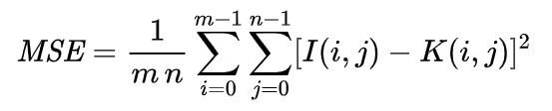
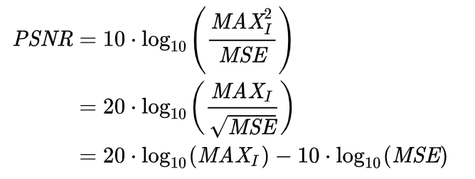
About PSNR (Peak Signal Noise Ratio)
PSNR is most easily defined via the mean squared error (MSE). Given a noise-free m×n monochrome image I and its noisy approximation K, MSE is defined as:
The PSNR (in dB) is defined as:
Here, MAXI is the maximum possible pixel value of the image. When the pixels are represented using 8 bits per sample, this is 255. More generally, when samples are represented using linear PCM with B bits per sample, MAXI is 2B−1.

Slide 16
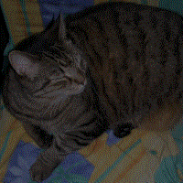


Framework and Algorithm

Slide 17
Hiding
Message
Source image
Text Message
AES Encryption
DCT Transformation
Embedding
IDCT Transformation
Writing of Stereography
Stereo Image

Slide 18
Displaying Message
Source image
DCT Transformation
Extraction
AES Decryption
Text Message

Slide 19
Algorithm For Gray Scale Images
Embedding
Encrypt the message using AES encryption system.
Take the image and divide the image into 8X8 blocks and subtracting with 128.
Apply DCT to each block and round it off.
Embed the message in each LSB of DCT coefficients.
Apply inverse DCT to each block and add each block by 128 and stich back the image in lossless image format (e.g., .png format).
Extraction
Take the stereo image and divide the image into 8X8 blocks and subtracting with 128.
Apply DCT to each block and round it off.
Extract the message from each LSB of DCT coefficients.
Decrypt the message using AES encryption system.

Slide 20
Algorithm For RGB Images
Embedding
Encrypt the message using AES encryption system.
Take the image and split it into three channels that is Red , Green and Blue.
Take the green channel and divide the image into 8X8 blocks and subtracting with 128.
Apply DCT to each block and round it off.
Embed the message in each LSB of DCT coefficients.
Apply inverse DCT to each block and add each block by 128 and stich back the image in lossless image format (e.g., .png format).
Extraction
Take the stereo image and Take the image and split it into three channels that is Red , Green and Blue.
Take green channel and the divide the image into 8X8 blocks and subtracting with 128.
Apply DCT to each block and round it off.
Extract the message from each LSB of DCT coefficients.
Decrypt the message using AES encryption system.

Slide 21

Results

Slide 22
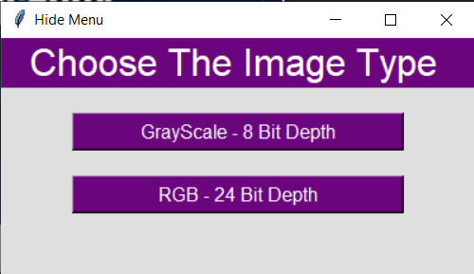
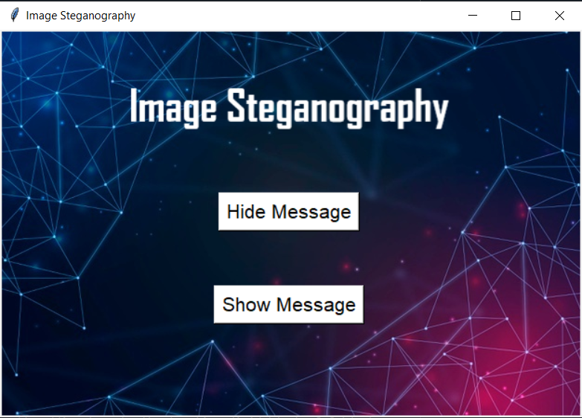
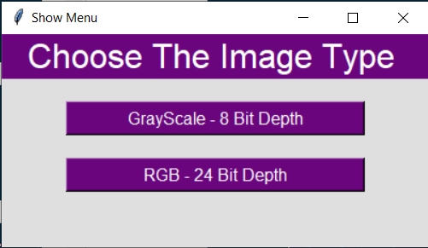
Screen Shots of User Interface

Slide 23
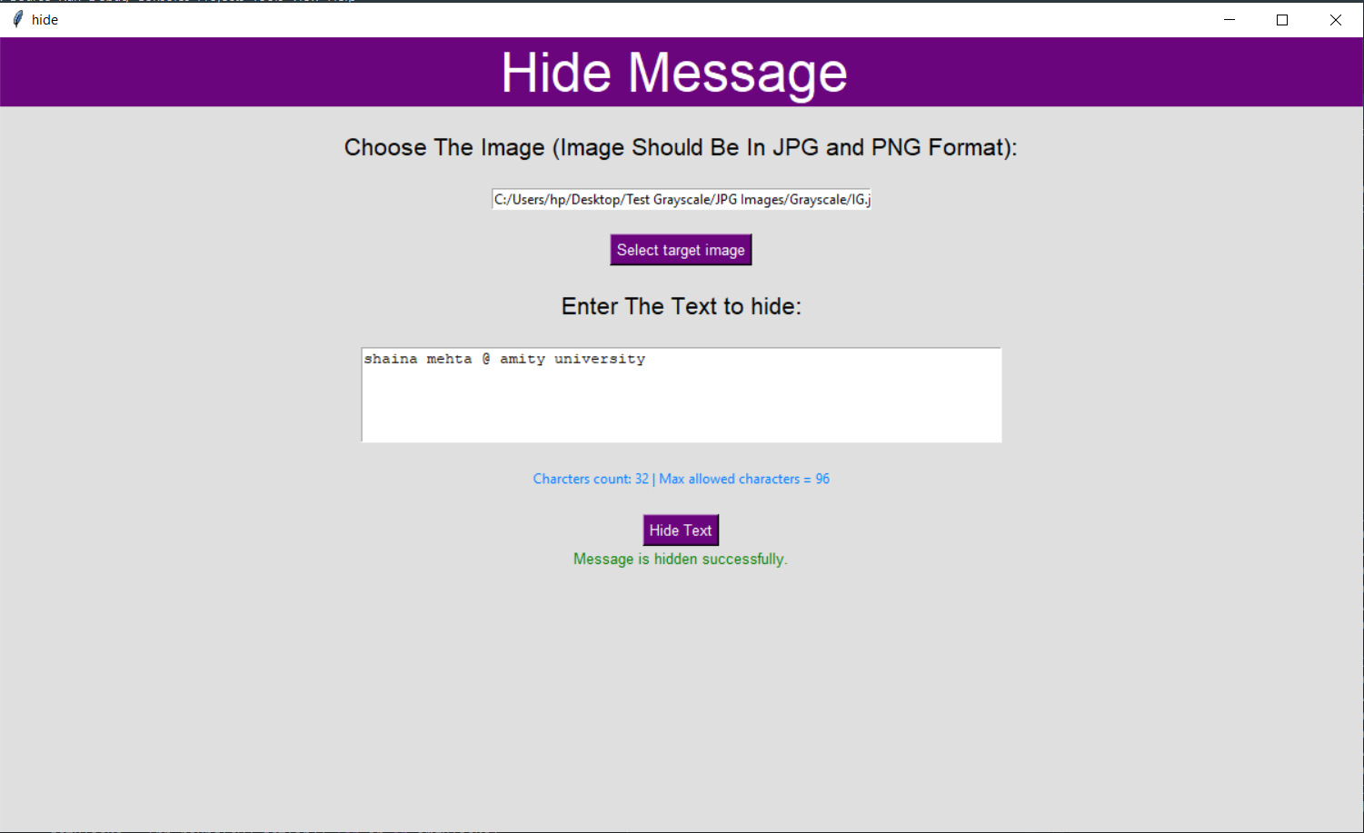
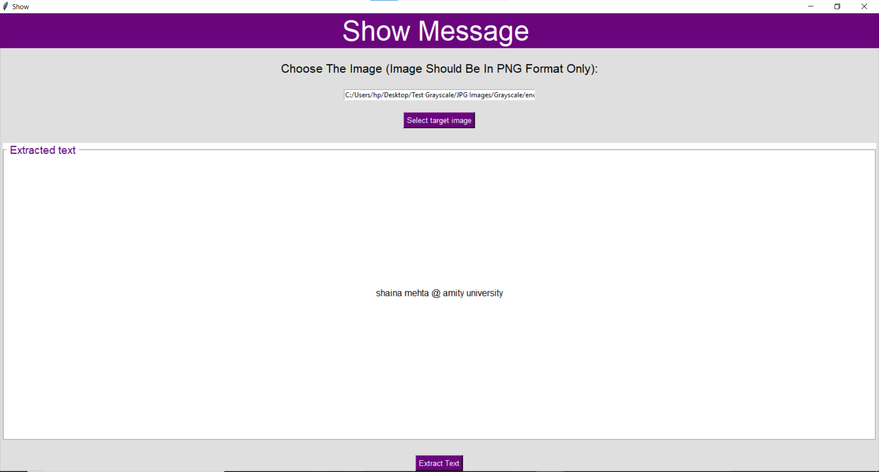

Slide 24
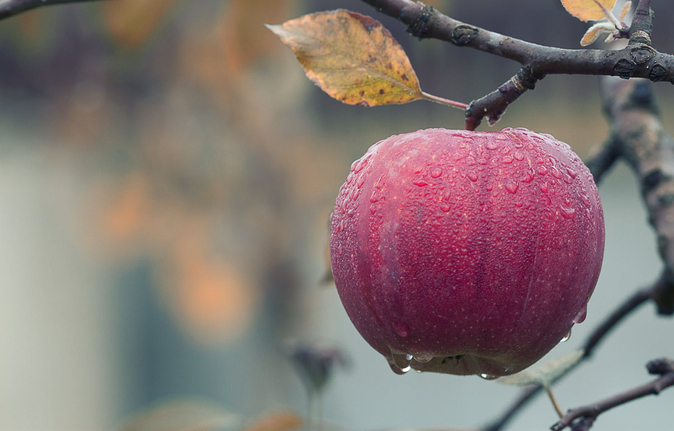
Output
Before
Apple1.png
After
enc_Apple1.png
PSNR is 50.96696736785725

Slide 25
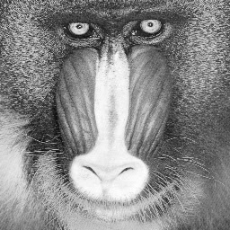
Output
Before
JG.png
After
enc_JG.png
PSNR is 41.44866206319571

Slide 26

Conclusion

Slide 27
Since the proposed technique is more secure than spartial technique, but it has some disadvantages. Firstly, it AES – 128 is not much secure in nature. Secondly, ECB mode used in AES -128 is least secure. Lastly, however dct is computationally fast stores images with less distortion but some of the messages cannot be extracted properly due to the increase in the noise level above 0.32bpp. DCT also does not provide proper robostness to geometric attacks. To overcome the disadvantages, one can use DWT and DFT instead of DCT or they can use Genetic algorithms and Lossless Image Compression techniques for solving message extraction problem and one can use AES-256 with more secure modes such as CBC and EAX for enhancing the security. Researchers are still figuring out many ways for finding out highly secure image steganography methods.

Slide 28
THANKS
Do you have any questions?
By: Tanya Yadav
and
Shaina Mehta

